Slide 1

Corporate Finance 3. Capital Budgeting
International Masters
Spring 2025 program
© Sylvie Appriou

Slide 2
Sessions calendar Group 1
Session nb | Date | Time |  | Contents
1 | Wednesday March 26th | 14:00 - 16:00 | KB601 | Introduction
2 | Thursday April 3rd | 09:00 – 11:00 | KB604 | Home work review + class
3 | Thursday April 17th | 11:00 – 13:00 | KB601 | Home work review + class
4 | Wednesday April 30th | 14:00 – 16:00 | KB601 | Home work review + class
5 | Tuesday May 6th | 09:00 – 11:00 | KB604 | Home work review + class
6 | Wednesday May 21st | 14:00 – 16:00 | KB601 | Home work review + class
7 | Wednesday May 28th | 15:00 – 16:00 | KB601 / KB604 | Exam

Slide 3
Sessions calendar Group 2
Session nb | Date | Time |  | Contents
1 | Thursday March 27th | 09:00 - 11:00 | KB601 | Introduction
2 | Thursday April 3rd | 11:00 – 13:00 | KB604 | Home work review + class
3 | Wednesday April 16th | 14:00 – 16:00 | KB604 | Home work review + class
4 | Tuesday April 29th | 09:00 – 11:00 | KB604 | Home work review + class
5 | Tuesday May 6th | 11:00 – 13:00 | KB604 | Home work review + class
6 | Thursday May 22nd | 09:00 – 11:00 | KB604 | Home work review + class
7 | Wednesday May 28th | 15:00 – 16:00 | KB601 / KB604 | Exam

Slide 4
Sessions calendar Group 3
Session nb | Date | Time |  | Contents
1 | Thursday March 27th | 11:00 - 13:00 | KB601 | Introduction
2 | Wednesday April 2nd | 14:00 – 16:00 | KB601 | Home work review + class
3 | Thursday April 17th | 09:00 – 11:00 | KB601 | Home work review + class
4 | Tuesday April 29th | 11:00 – 13:00 | KB601 | Home work review + class
5 | Wednesday May 7th | 14:00 – 16:00 | KB604 | Home work review + class
6 | Thursday May 22nd | 11:00 – 13:00 | KB604 | Home work review + class
7 | Wednesday May 28th | 15:00 – 16:00 | KB601 / KB604 | Exam

Slide 5
Course schedule and contents
Session 1
Introduction
Corporate Finance general concepts
Review of key Financial statements
Session 2
Cash vs Profit
Key Financial indicators
Planning and Budgeting introduction
Session 3
Planning and budgeting continuation
Budgeting Case study
Session 4
Case study correction
Cost Management
Capital investment introduction
Session 5
Capital investment continuation
Project value case methodologies
Session 6
Real life example : Project Value case
Introduction to Cost Accounting

Slide 6
Portfolio based investment planning

Slide 7
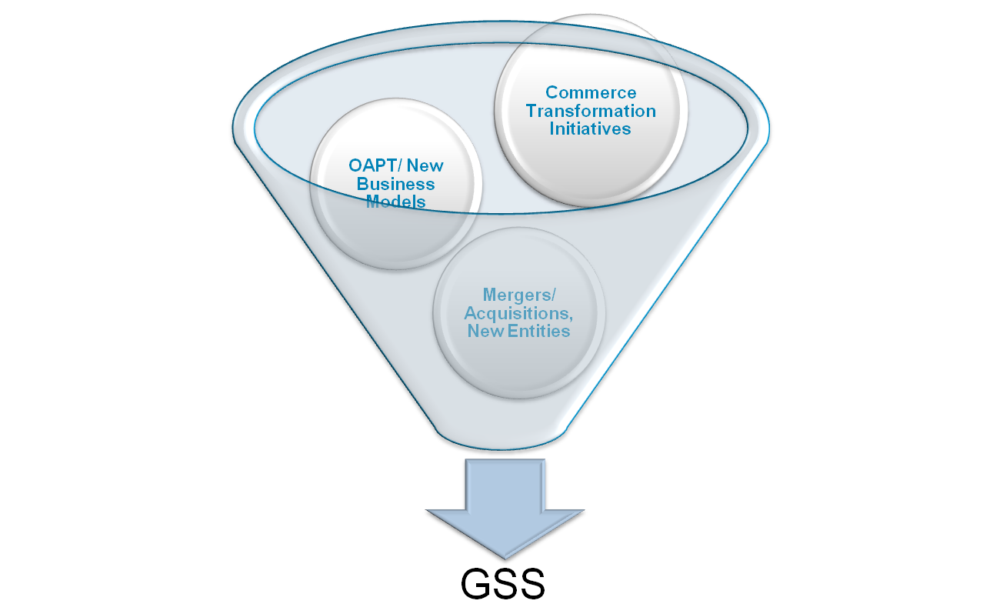
Demand Management
Demand management
IT : from Internal Service provider to Strategic differentiator
Planned vs unplanned demand (change requests, bug fixes…)
Ideas / Opportunities
Capture demand and identify opportunities
Ideas
Ideas
Project requests
Build business case
Seek executives approval
Projects
Perform detailed budgeting
and planning
Approved demand

Slide 8
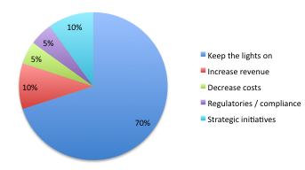
Portfolio based investment planning
Project Portfolio Management (PPM) vs Project / project
Framework for prioritization
Define categories and target % in line with company strategic priorities
Monitor actual projects vs target portfolio

Slide 9
Portfolio based investment planning
Project Portfolio Management (PPM)
Business objectives – Function – Budget (bubble size)
 | Marketing | Sales | Order management | Customer service | Finance
Increase revenue
Decrease costs
Regulatory / Compliance
Strategic initiatives

Slide 10
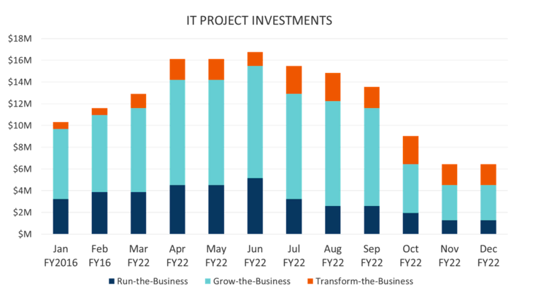
Portfolio based investment planning
Metrics reporting example

Slide 11
Introduction to Capital Budgeting

Slide 12
What is Capital Budgeting ? (1/2)
The goal of Capital budgeting is to estimate the financial viability of a capital investment over the life of the investment
Applicable to all investments :
Construction of a new plant
Investment in an outside venture
Projects
….
Based on an evaluation of :
Investment costs
Investment returns

Slide 13
What is Capital Budgeting ? (2/2)
In the context of IT, used to :
Quantify the value of a given IT project
Decide on the Go / NoGo for a project
Prioritize projects
Process
Determine the project costs
Determine the project benefits or returns
Apply Financial metrics :
Payback period
ROI : Return on Investment
NPV : Net Present Value
IRR : Internal Rate of return
…

Slide 14
Time value of money
A dollar today is worth more than a dollar tomorrow
Video
Future value, Present value, Interest…
Future Value : based on the “compound interest” methodology
FV = PV (1+i) on 1 period
FV = PV (1+i)^{n}
i is the interest rate or discount rate or hurdle rate or Cost of capital
n is the nb of periods
Present Value
PV = FV / (1+i)^{n}

Slide 15
Opportunity cost
Opportunity costs represent the potential benefits that an individual, investor, or business misses out on when choosing one alternative over another.
Because opportunity costs are unseen by definition, they can be easily overlooked.
Opportunity cost is the forgone benefit that would have been derived from an option not chosen.
To evaluate opportunity costs, the costs and benefits of every option available must be considered and weighed against the others.
Considering the value of opportunity costs can guide individuals and organizations to more profitable decision making.
Video

Slide 16
Discounted Cash flows
Discounted cash flow (DCF) is a valuation method used to estimate the value of an investment based on its expected future cash flows.
DCF analysis attempts to figure out the value of an investment today, based on projections of how much money it will generate in the future.
It converts all future cash flows to their current value
DCF = CF1/ (1+r) + CF2/ (1+r)²+ CF3/ (1+r)³+….+CFn/(1+r)^{n}
Basis for NPV : Net Present Value and IRR : Internal rate of Return
Video

Slide 17
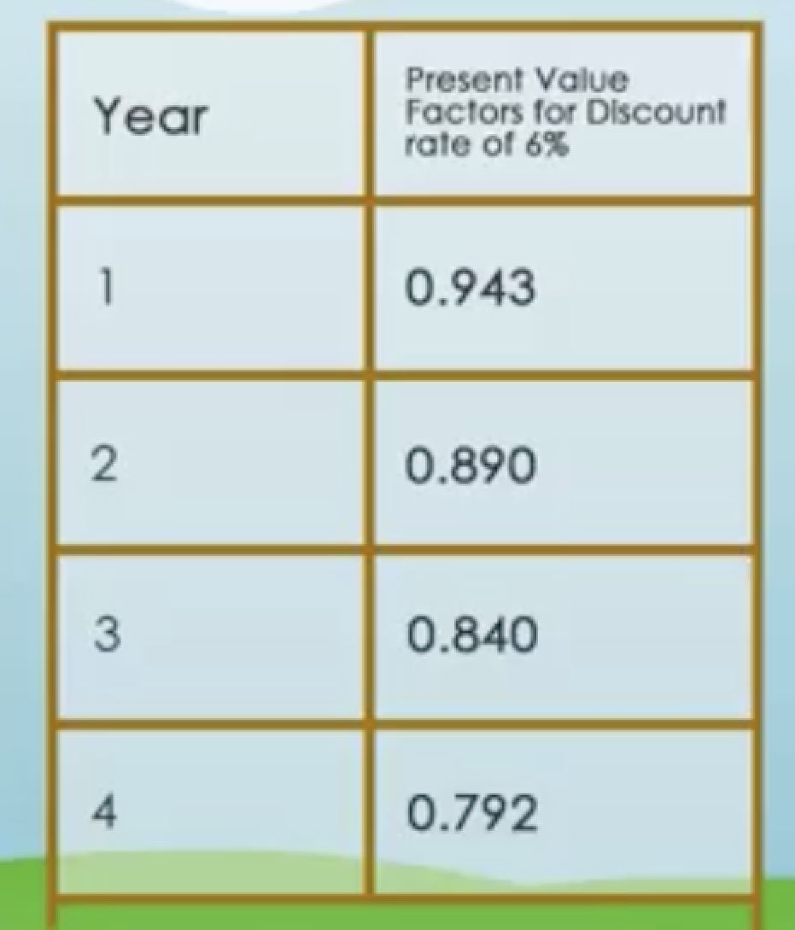

Discounted Cash flows
Future Value :
FV = PV (1+i)^{n}
i is the interest rate or discount rate or hurdle rate or Cost of capital
n is the nb of periods
Present Value
PV = FV / (1+i)^{n}

Slide 18
Project value case

Slide 19
What is project value case?
A value case, or business case, is the fundamental analysis of the cost of a project, system cost, feasibility, risks, benefits and economic return. This analysis combines quantitative and qualitative data in a prioritized fashion to render a written, comprehensive, and defensible justification for undertaking a transformation.
The value case delivers four important benefits:
Organizational agreement - The value case, and the value case development process, is a format for the organization to reach agreement on initiatives and projects, goals and financial expectations.
Economic justification - The value case provides the hard numbers for costs and projected benefits to measure return on investment.
Documented proof - The value case is a tangible, referenced, written testament for the organization that can be used on an ongoing basis to reaffirm commitments and measure progress.
Confidence (vs. hope) - The value case replaces intuition, hope, and optimism with confident business decisions made on sound analysis.

Slide 20
What is project value case?
Despite their benefits, value cases are often not completed for even large, high-risk projects. There are several reasons, all of which can contribute to the failure of proper business justification. These include
Skipping the value case because of enthusiastic mandates from management
Not having the skills or bandwidth to complete one.
The value case helps make tough business decisions by providing clear economic justification for IT projects and initiatives.
More importantly, the value case is a process by which all necessary decision-makers come to agreement on the decision criteria and justification.
A less-than-perfect value case is better than no value case at all…

Slide 21
Practically project value case…
… is also about:
Project assessment and prioritization
Need to win consensus and win others
Need for a robust process & review framework
Sometimes require managing upwards
Requires common evaluation criterion
Need discipline… and common sense

Slide 22
Financial Benefits categories
Benefits category / Savings | Explanation
Operating costs reduction | Net reduction in costs the company is spending today and will stop spending as a result of doing the project
Cost avoidance | Cost avoidance is defined as the benefits realized by reducing / avoiding future expenditure although the projected expenditures have not been budgeted or obligated
Productivity gains | Productivity savings are defined as the time saved or freed up as a result of doing the project
Financial penalty savings | Savings resulting from financial penalties going away

Slide 23
Other Benefits categories
Revenue generation
Compliance
Customer satisfaction
Employee development / satisfaction
Process standardization
Data / system security
User experience
Brand image
….

Slide 24
Cost categories
Cost categories | Explanation
Business resource costs | Project team business resource costs (permanent, Temp or contractors)
IT resource costs | Project team IT resource costs (permanent, Temp or contractors)
Infrastructure (HW) costs | Servers, Telecoms equipment etc….
SW licence costs
Organization adoption costs | Training, communication etc…
Maintenance / support costs | Cost to support once project is live

Slide 25
Project assessment methods
Cost Benefit criteria:
Return on investment (ROI)
Payback period
Net present value (NPV)
Internal Rate of Return (IRR)
Etc…
General criteria:
Strategic alignment
Risk level
Size of initial investment
Criticality level
Etc…
… And others you may have or may encounter…

Slide 26
Return on Investment (ROI)
This term means different things to different people…Many business managers use the term in a general sense as a means of assessing the merit of an investment or business decision.
In simple terms this the “profit” made from an investment.

Slide 27
Project ROI
Why is ROI Important?
It quantifies project value
Perhaps the most important aspect of ROI is its ability to show business leaders dollar/currency figures of a project’s worth.
ROI turns the subjective into the objective, which can often turn uncertainty into support.
It can build stakeholder support
Tying a dollar/currency value to a project may help with a “go/no-go” decision.
Many times, stakeholders want to see what the dollar/currency value is to them if they are to support a particular project.
It can lead to project prioritization
Once the decision has been made to launch a project, ROI helps determine the project’s ranking among other priorities
Usually, projects with greater ROI are ranked higher and gain resource support more quickly.

Slide 28
Project ROI
How to Calculate ROI
ROI = [(Financial value – Project cost) / Project cost] x 100
Note: In looking at the formula, there are two components we need to determine: Financial value (or project benefits) and project cost.

Slide 29
Project ROI
Financial value or Project Benefits
Financial value is the project’s payback.
Calculating value can be complicated based on the uncertainty of assigning actual dollars to a proposed outcome.
Process should qualify the benefits then quantify each of the identified benefits
Project costs
Project cost is calculated by determining all project costs and expenses over time.
Note: Best practice is to be conservative, ie under estimate benefits and over estimate costs…to be on the safe side….

Slide 30
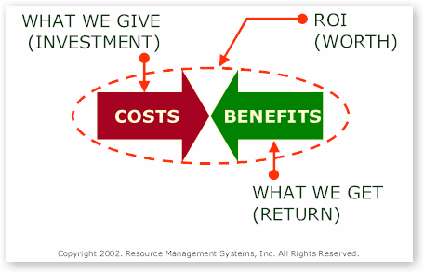
Project ROI

Slide 31
Project ROI example
If total project costs are $300,000 and expected gains are $360,000, the ROI will be:
ROI = [(Financial value – Project cost) / Project cost] x 100
[($360,000 – $300,000 ) / $300,000 ] x 100
Or 20%

Slide 32
Payback period
Payback = How much time it takes to recover the costs of a project….or how long it takes for the project benefits to outweight the project costs
When we are managing a business or a project, we care very much about how quickly we get our money back.
It is a reality that some companies (or project sponsors) choose the less-profitable investment if they get their money back faster.
The most common reasons for this decision would be if a company was strapped for cash, and did not want to use debt to finance operations.

Slide 33
Payback period
When using payback period, companies will usually have a standard time period, such as two years...
Any project that has a payback period of less than the standard will be acceptable.
Those projects that take longer to return the original investment than the standard period will not be acceptable.

Slide 34
Payback period
How to Calculate Payback period, when cash inflows are even:
Payback period = Project cost / Annual cash inflows
In case of uneven cashflows, calculate the total project costs, then accumulate the benefits year after year until the total becomes higher than the costs…
Notes:
There are two main problems with the payback period method:
1. It ignores any benefits that occur after the payback period and, therefore, does not measure profitability.
2. It ignores the time value of money.
Because of these reasons, other methods of capital budgeting, like Net Present Value, are generally preferred.

Slide 35
Payback period example
If a project costs $100,000 and is expected to return $20,000 annually, the payback period will be:
Payback period = Project cost / Annual cash inflows
$100,000 / $20,000
Or five years

Slide 36
Net Present Value (NPV)
Contrarily to ROI and payback methodologies, NPV takes into account the time value of money
It is a more sophisticated / accurate measure….It is also more complex….
There are different and complex ways to construct NPV formulae but basically it is no more than translating the project future cash flow value into their present values and adding them all up…(See Discounted Cash Flow….)
If the NPV of a prospective project is positive, then it is profitable and is worth of consideration.
If negative then it's unprofitable and should not be pursued.

Slide 37
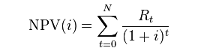
Net Present Value (NPV)
NPV is the sum of the PV (Present values) of incoming and outgoing cash flows over a period of time.
Present Value : based on the “compound interest” methodology
FV = PV (1+i) on 1 period
FV = PV (1+i) ^n
PV = FV / (1+i)^n
NPV definition

Slide 38
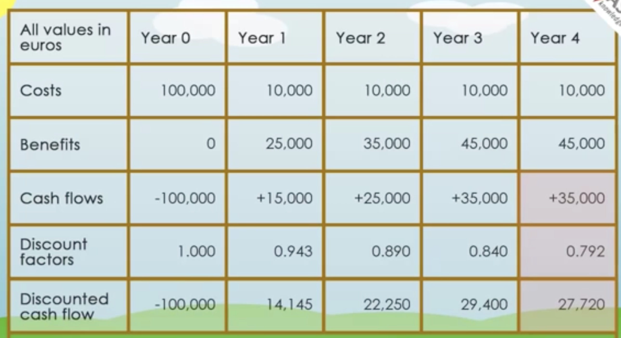
Net Present Value (NPV)

Slide 39
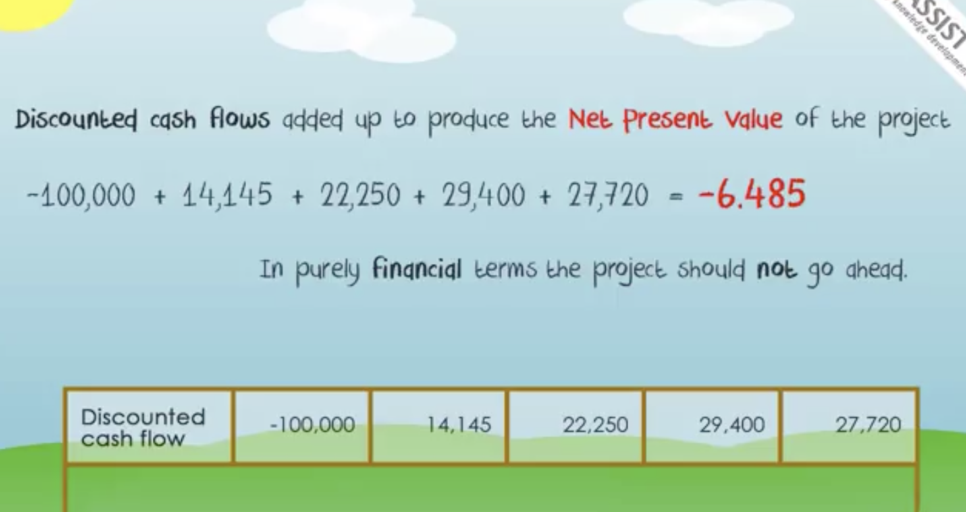
Net Present Value (NPV)

Slide 40
Net Present Value (NPV)
Discount rate:
Discount Rate can be considered as the rate of return required by the investor which includes costs, risks and lost opportunities.
To make comparison meaningful between projects (for prioritization for example…), Projects should be assed with the same time horizon and Discount rate
However, the discount rate which is used for evaluating projects can vary in time and between different firms
Discount rate will be given to you by Finance or project office : it is not something you’ll have to determine

Slide 41
NPV example
Even Cash Inflows:
Calculate the net present value of a project which requires an initial investment of $243,000 and it is expected to generate a cash inflow of $50,000 each month for 12 months. The target rate of return is 12% per annum.

Slide 42
NPV example
Solution:
Initial Investment = $243,000
Net cash Inflow per period = $50,000
Number of periods = 12
What is the Discount rate per period?
Discount rate per period = 12% ÷ 12 = 1%
Net Present Value
NPV ≈ $319,754

Slide 43
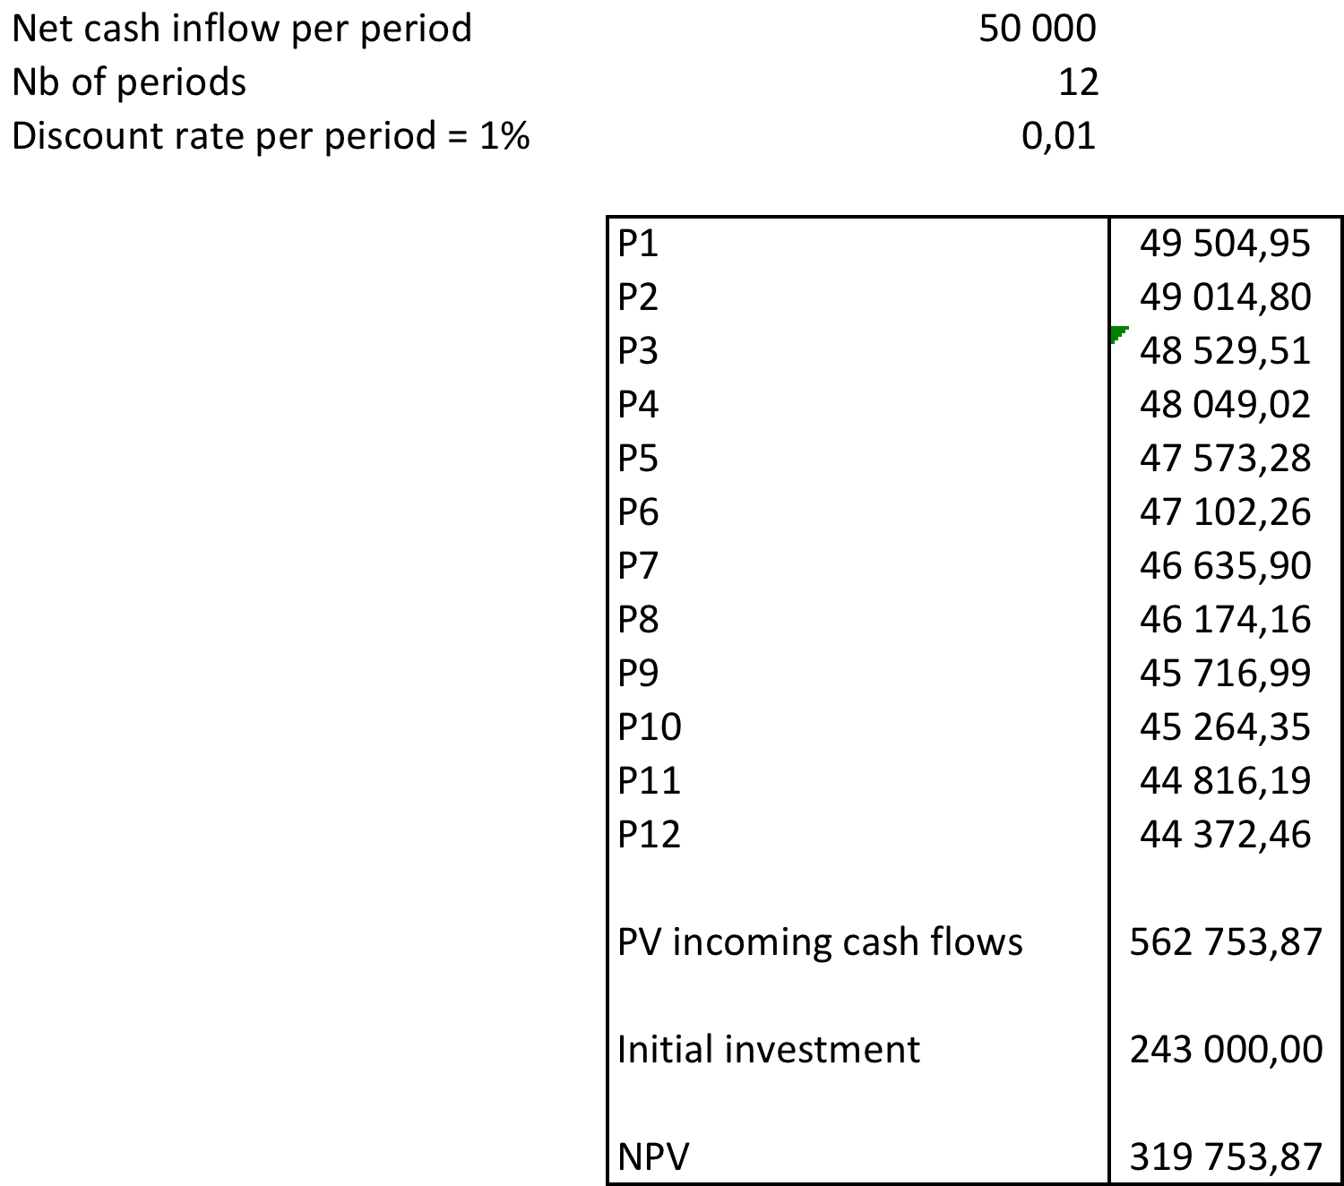
NPV example

Slide 44
IRR : Internal Rate of Return
IRR Internal Rate of Return is a variation on NPV
It is the discount rate that results in NPV = 0
Calculated through trial and error or with calculator spreadsheet
The higher the IRR, the more valuable the project
You would need to find an investment that returns at least the IRR as an alternative to the project
If IRR > Discount rate : accept the project (NPV positive)
If IRR < Discount rate : reject the project (NPV negative)
Video : NPV and IRR

Slide 45
Profitability index
Also a variation on NPV methodology…
It “normalized” NPV so that bigger projects are not at an advantage
Profitability index is the Present value of future expected cash flows / Initial investment
PI = (PV of future Cash flows) / Initial investment
Should be higher than 1 for the project to be attractive

Slide 46
Thank you!
See you next time

